Slide 1
03 MONTHS PROGRESS REPORT OF PHARMA MICROBIOLOGISTS FORUM
(JAN-MAR’26)

Slide 2

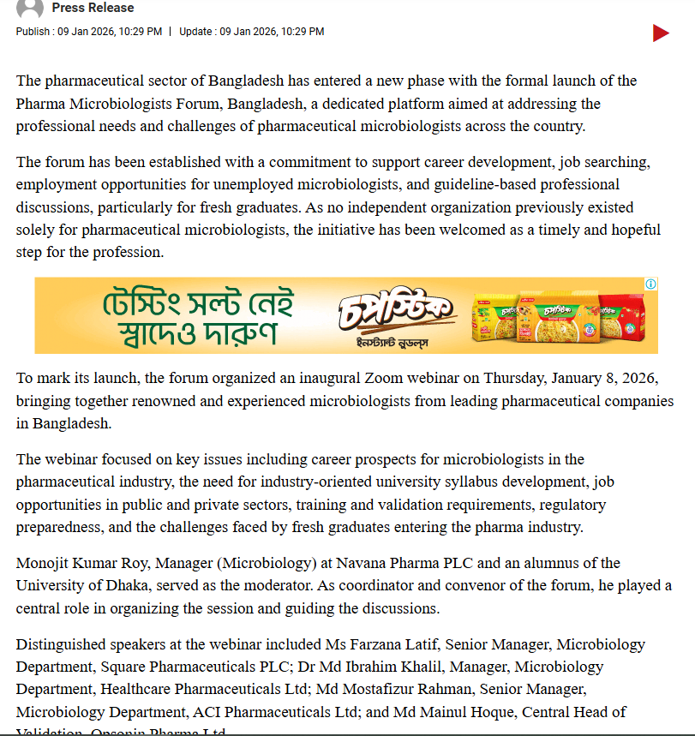


Slide 3
MEMBERSHIP REGISTRATION

Slide 4

MEMBER REGISTRATION PROCESS
FREE MEMBERSHIP THROUGH GOOGLE FORM
289 MEMBERS REGISTERED
UNIQUE MEMBER REGISTRATION NUMBER

Slide 5


Slide 6
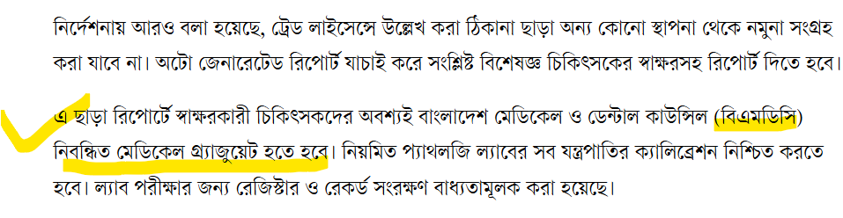



Slide 7

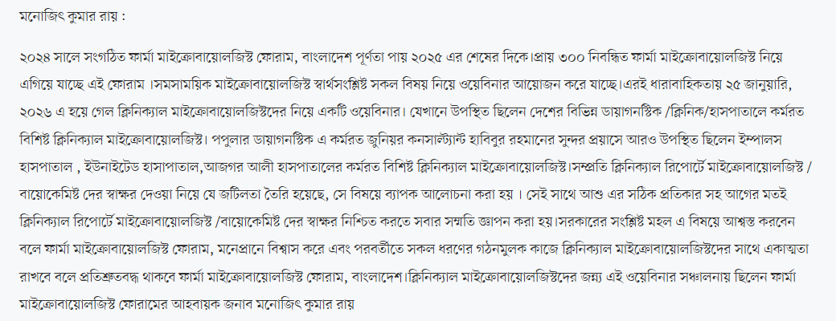

Slide 8
ONLINE TRAINING

Slide 9




Slide 10


Slide 11
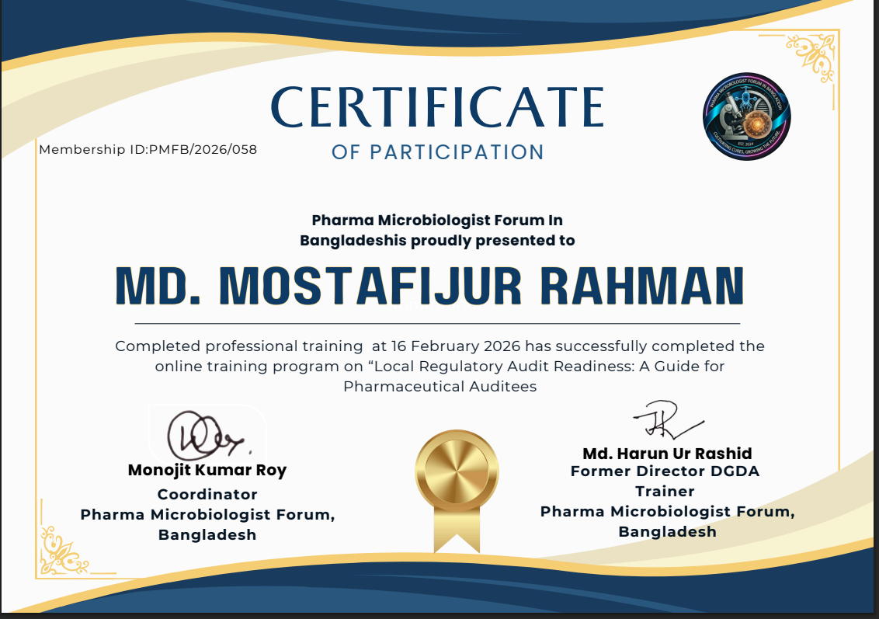

Slide 12
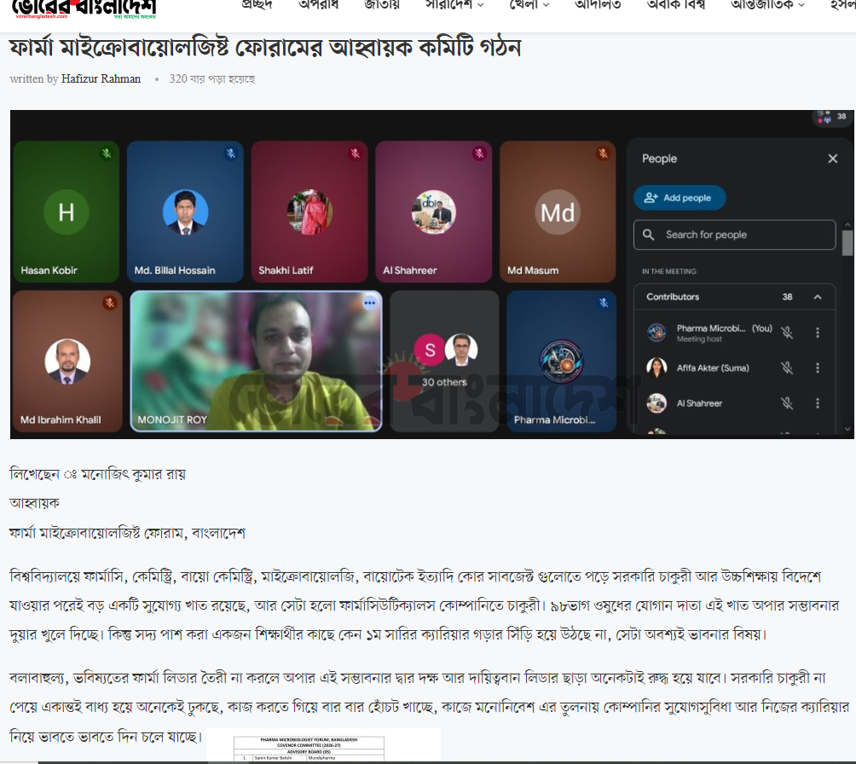
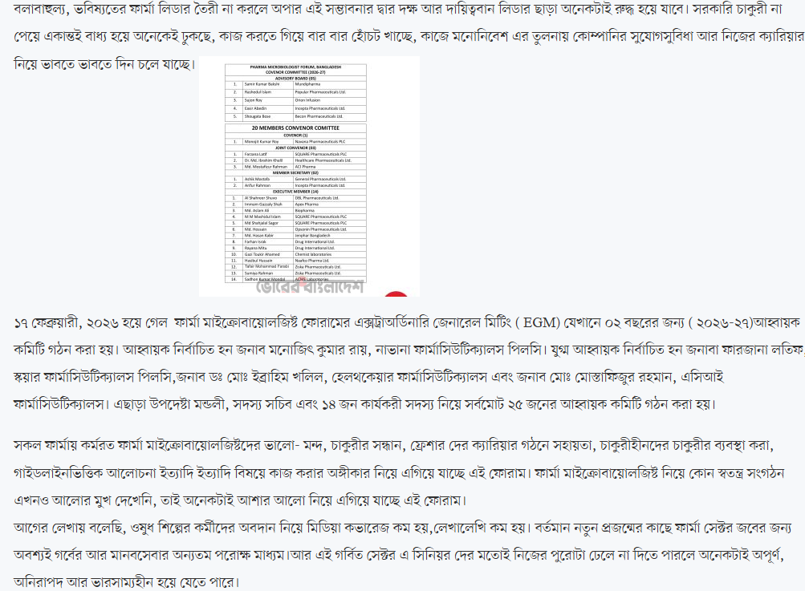

Slide 13



Slide 14

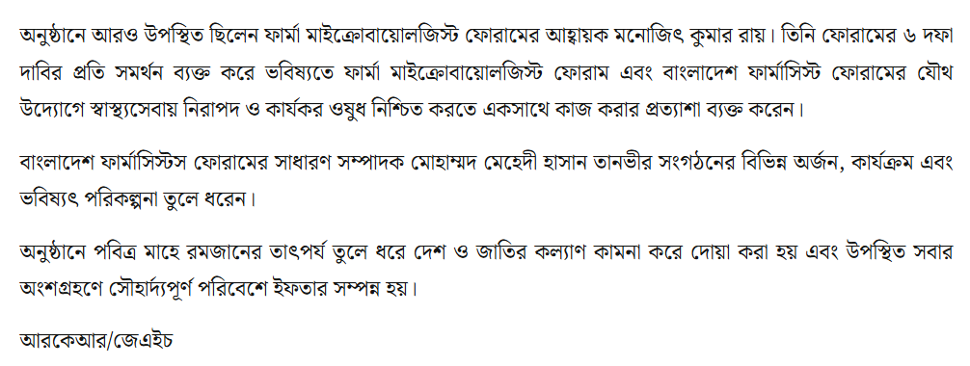

Slide 15

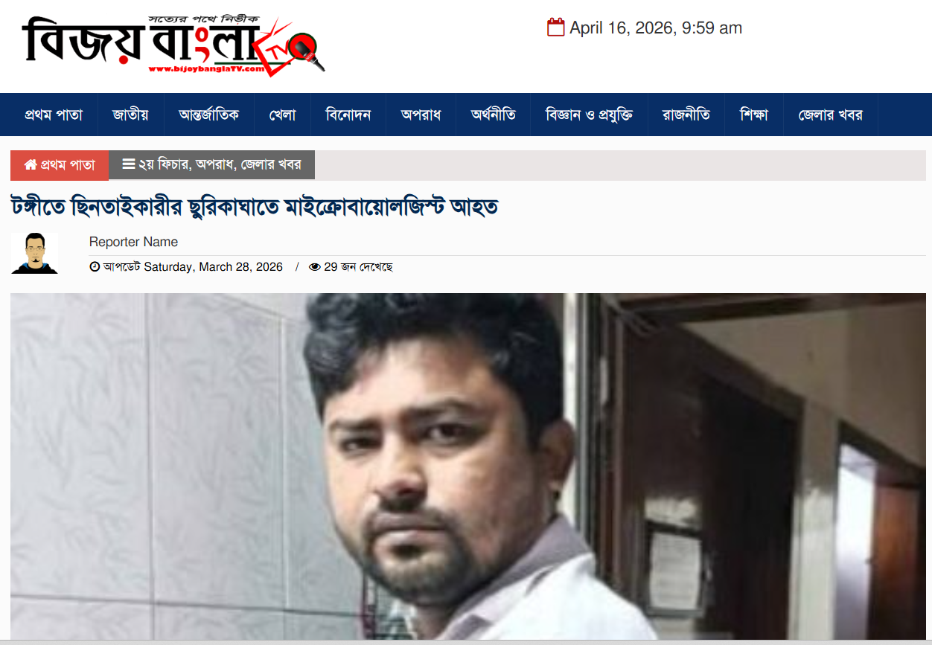

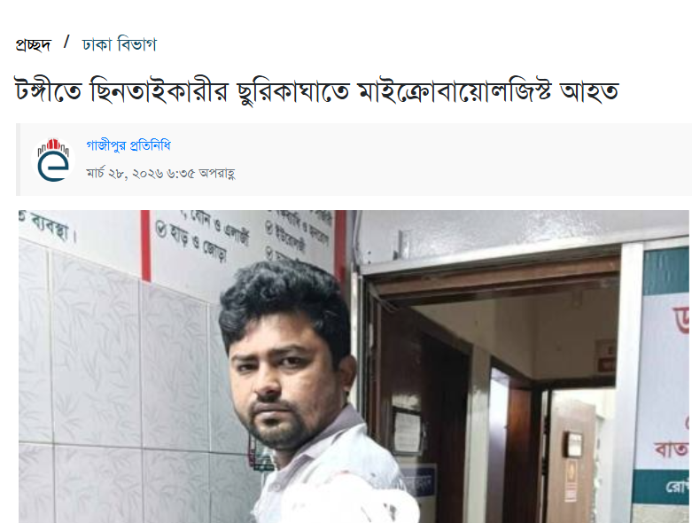

Slide 16






Slide 17
NEXT MAJOR PLAN!
FORUM REGISTRATION (NEED FUNDING):WITHIN JUNE 2026
WEBSITE DEVELOPMENT (NEED FUNDING):WITHIN JUNE 2026
PRIVATE-PUBLIC UNIVERSITY DISCRIMINATION RESOLVE IN JOB CIRCULAR: CONTINUOUS PROCESS ( NEED REGISTRATION TO MOVE OFFICIALLY)
FUND RAISE FOR FORUM MEMBER OR DISTRESSED PEOPLE ( ILLNESS/ACCIDENT/LOAN/CONTRIBUTION /DONATION/NATURAL CALAMITY ETC)
CONSITUTION APPROVAL:WITHIN MAY 2026
ONLINE/OFFLINE TRAINING: CONTINOUS PROCESS

Slide 18
MEMBER REGISTRATION FEE FOR 2026
500 Taka/member for 2026

Slide 19
AGM OF FORUM
PROPOSAL:
AGM WILL BE HELD ON JANUARY 2027
To form a new elected committee under election process
CURRENT CONVENER COMMITTEE WILL BE EXPIRED ON DECEMBER -2026

Slide 20
THANKS

